Slide 1
Converter conceptual diagram
for mapping of electronic equivalents of railway bills in UN/EDIFACT standard into CEFACT UN and reverse
Railway Consignment Note
Electronic equivalents
of documents (UN/EDIFACT)
MMT RDM
Electronic equivalents
of documents (UN/EDIFACT)
UN/EDIFACT
CIM/SMGS
Data Converter
XML – ДОК:
СМГС (xml)
ЦИМ/СМГС (xml)
ЦИМ (xml)
О+Р 943
О+Р944
CIM
IFTMIN
SMGS

Slide 2
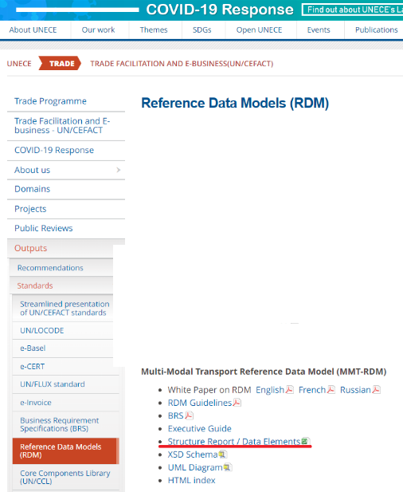
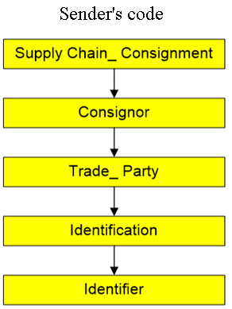
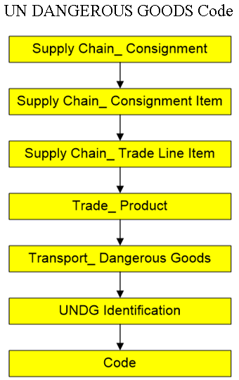
Path in MMT

Slide 3
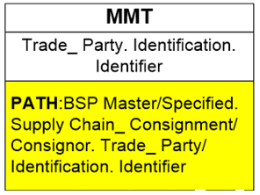
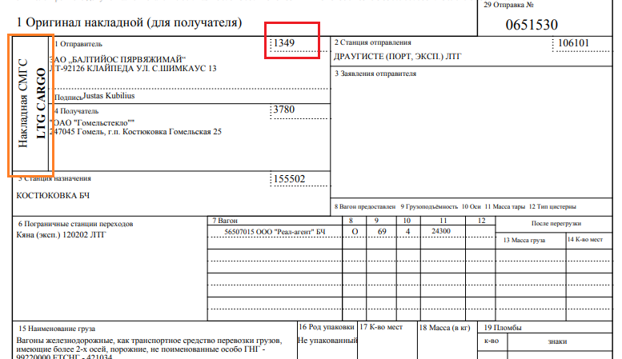
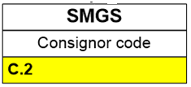
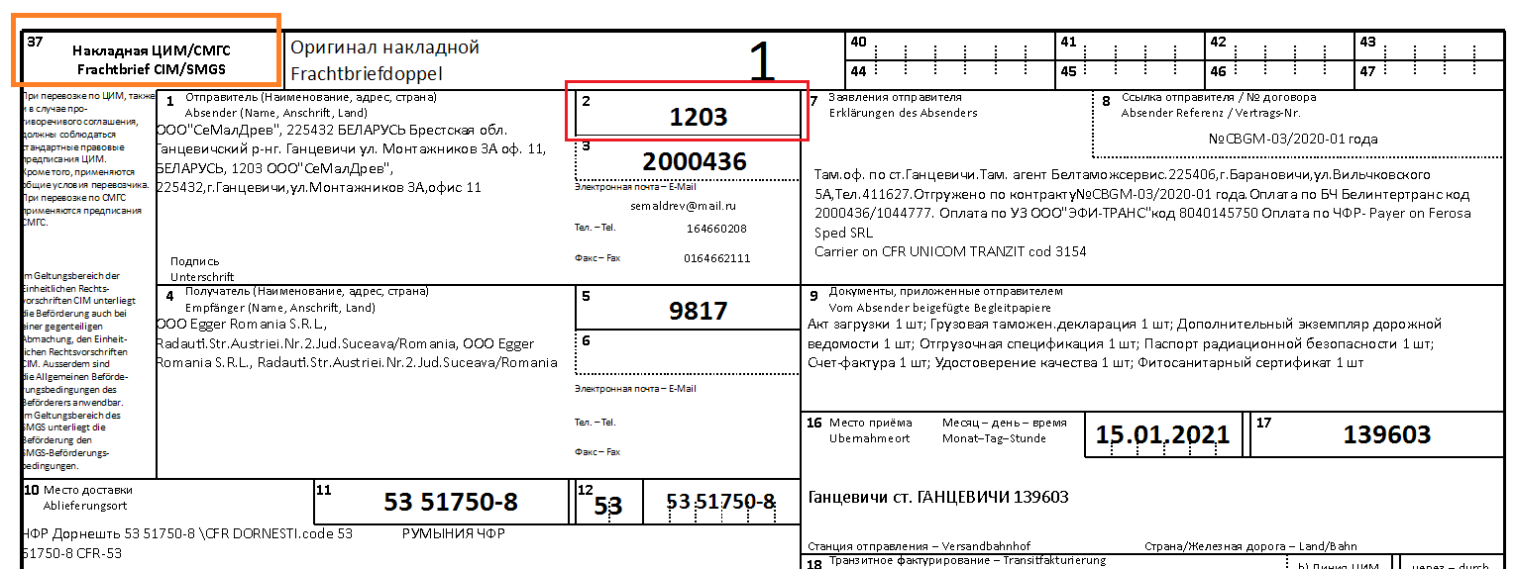
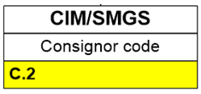
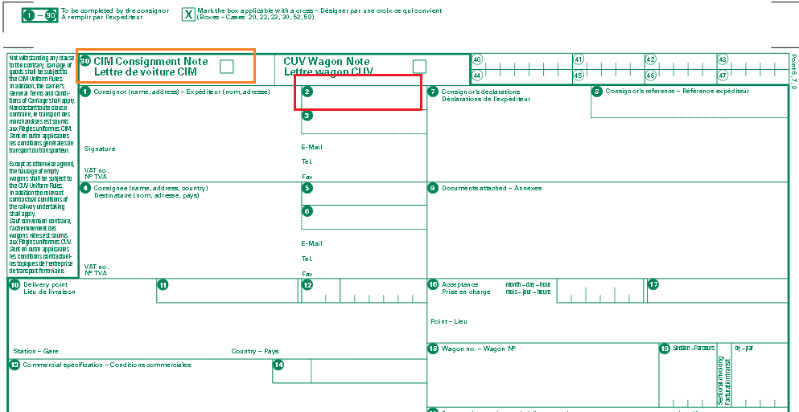
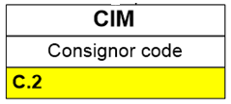

Slide 4
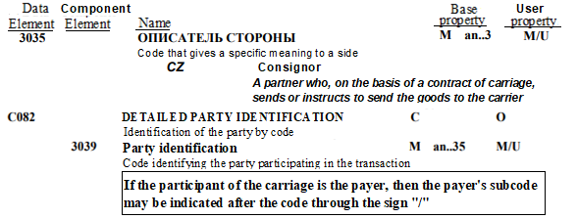
MMT (CIM-SMGS Consignment Note.TDED)
SMGS--IFTMIN
IFTMIN - MMT)

Slide 5
XML
IFTMIN
<Supply Chain_ Consignment>
…
<Consignor>
<Trade_ Party>
<Identification>
<Identifier>
Consignor_Identifier
…
CIM/SMGS
MMT Reference Data Models
Data in EDIFACT
standart
CIM
…
…
NAD+CZ+Х:Type++ NAME:NAME:NAME: NAME:NAME:LNG+AD+ Т5++Y+Z’
…
…
SMGS
Data Converter
JSON
…
"Supply Chain_ Consignment" : {
…
"Consignor" : {
"Trade_ Party" : {
" Identification" : {
"Identifier“ :
Consignor_Identifier
…

